Slide 1


Asad Gulib
05/25/2024

Slide 2

Outline
Executive Summary
Introduction
Methodology
Results
Conclusion
Appendix

Slide 3
Executive Summary
Summary of methodologies
Data collection through SpaceX API and web scrapping.
Data wrangling to create success/fail outcomes.
Exploratory data analysis with SQL.
Data visualization.
Interactive visual analysis with folium.
Build machine learning models to predict outcomes.
Summary of all results
Launch sites has better success rate over time.
KSC LC-39A has the highest success rates among the launching sites.
Higher payloads has higher success rates.
Orbits GEO, HEO, ES-L1 and SSO has 100% success rate

Slide 4
Introduction
Project background and context
SpaceX, a pioneering force in the space sector, aims to democratize space travel by making it more affordable. Their achievements range from delivering spacecraft to the International Space Station to launching a satellite network for global internet coverage and conducting manned space missions. A key factor enabling their cost-effectiveness is their innovative reuse of the first stage of the Falcon 9 rocket, which significantly reduces launch expenses to $62 million per launch. In contrast, other providers, lacking this reuse capability, incur costs of up to $165 million per launch. By predicting the first stage's successful landing, we can determine the launch price.
Problems you want to find answers
Leveraging public data and machine learning models, we can forecast whether SpaceX or its competitors can achieve first-stage reuse. Key areas of exploration include the impact of payload mass, launch site, number of flights, and orbits on landing success, the trend of successful landings over time, and identifying the most accurate predictive model for successful landing through binary classification analysis.

Slide 5

Section 1

Slide 6
Methodology
Executive Summary
Collect data from SpaceX API and Wikipedia
Filtering the data, handling the missing value and applying one hot encoding
Perform exploratory data analysis (EDA) using visualization and SQL
Visualize using Folium and Plotly Dash
Build classification models to predict the outcomes and choose the best model

Slide 7
Data Collection
Collect data using SpaceX REST API and web scraping techniques.
Wrangle data by filtering the, handling missing values and applying one hot encoding to prepare the data.
Explore data via EDA with SQL and data visualization techniques.
Visualize the data using Folium and Plotly Dash.
Build Models to predict landing outcomes using machine learning models.

Slide 8
Data Collection – SpaceX API
Request and parse the SpaceX launch data using the GET request
Filter the dataframe to only include Falcon 9 launches
Replace missing values with the mean value of PayloadMass.
GitHub URL
https://github.com/gulib/Coursera-Capstone-Project/blob/main/spacex-data-collection-api.ipynb
Request and parse SpaceX data
Filter the dataframe
Deal with missing values

Slide 9
Data Collection - Scraping
Request data from Wikipedia.
Create BeautifulSoup object from HTML response.
Collect data from HTML tables
Create dataframe from the data
Export the dataframe to CSV file
GitHub URL
https://github.com/gulib/Coursera-Capstone-Project/blob/main/Space%20X%20Landing%20Prediction.ipynb
Request data from Wikipedia
Create BeautifulSoup object from HTML
Create dataframe from HTML
Export dataframe to CSV

Slide 10
Data Wrangling
Perform exploratory data analysis (EDA) on the dataset
Calculate number of launches at each site, number of occurrence at each orbits
Create landing outcome label and export the results to CSV.
GitHub URL
https://github.com/gulib/Coursera-Capstone-Project/blob/main/spacex%20landing%20prediction-Data%20wrangling.ipynb

Slide 11
EDA with Data Visualization
Charts
Flight number vs. payload
Flight number vs. launch site
Payload mass vs. launch site
Payload mass vs. orbit type
GitHub URL
https://github.com/gulib/Coursera-Capstone-Project/blob/main/eda-data-visualization.ipynb

Slide 12
EDA with SQL
Queries
Names of unique launch sites
5 records were launching site name begins with ‘CCA’
Total payload mass carried by boosters launched by NASA
GitHub URL
https://github.com/gulib/Coursera-Capstone-Project/blob/main/eda-sql-coursera_sqllite.ipynb

Slide 13
Build an Interactive Map with Folium
Added blue circle at NASA Johnson’s Space Center’s coordinate with a popup label.
Added red circles at all launch site coordinates with a popup label showing its name.
Added colored markers of successful and unsuccessful launches at each launch site.
Added colored lines to show distance between a launch site and to nearest coastline, railway, highway and city.

Slide 14
Build a Dashboard with Plotly Dash
Created a dropdown list with launch sites that allow users to select all launch sites or a certain launch site.
Created a Pie chat to allow user to see successful and unsuccessful launches as a percentile.
Allow users to select payload mass range as a slider.
Created a scatter chart showing payload vs. success rate that allow user to see the correlation.
GitHub URL
https://github.com/gulib/Coursera-Capstone-Project/blob/main/dash%20spacex.ipynb

Slide 15
Predictive Analysis (Classification)
Logistic regression, support vector machine, decision tree and k nearest neighbors – this four classification models were built and compared.
GitHub URL
https://github.com/gulib/Coursera-Capstone-Project/blob/main/SpaceX_Machine%20Learning%20Prediction_Part_5.ipynb
Data preparation and standardization
Test and train each model with hyperparameters
Compare the results to find the best model

Slide 16
Results
Exploratory data analysis results
KSC LC-39A has the highest success rate among the landing sites.
Orbits ES-L1, GEO, HEO and SSO has the 100% success rate.
Interactive analytics demo in screenshots
Most launch sites are near the coast.
Launch sites are far from city so the failed launch has minimum damage to property and human.
Predictive analysis results
Decision tree has the best prediction among the 4 models.

Slide 17

Section 2

Slide 18
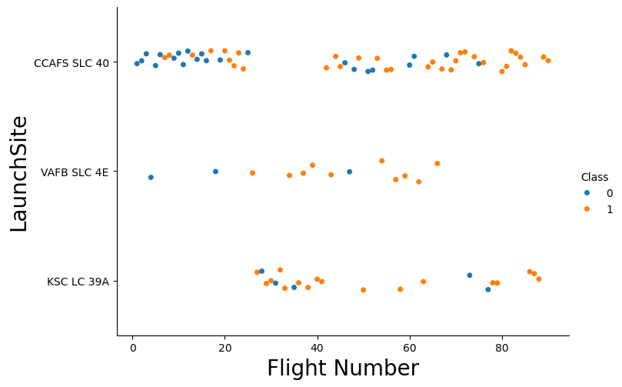
Flight Number vs. Launch Site
Exploratory Data Analysis:
VAFB SLC 4E and KSC LC 39A has higher success rate.
Earlier flights has lower success rate and later flights has higher success rate.

Slide 19
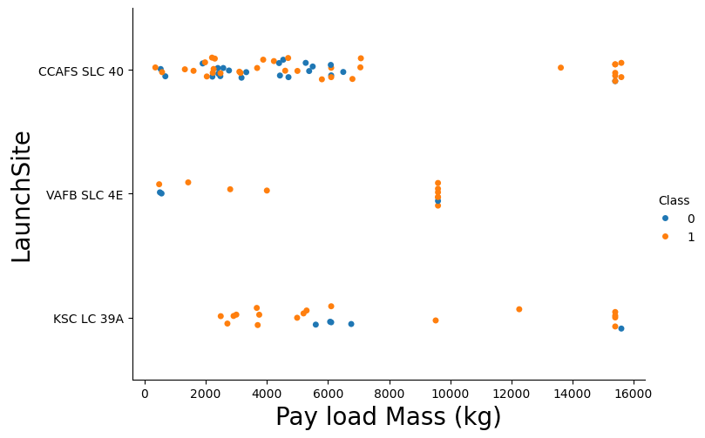
Payload vs. Launch Site
Exploratory Data Analysis:
The higher payload mass has higher success rate.
Flights with 8000 kg payload has higher success rate.
KSC LC 39A has 100% success rate.

Slide 20
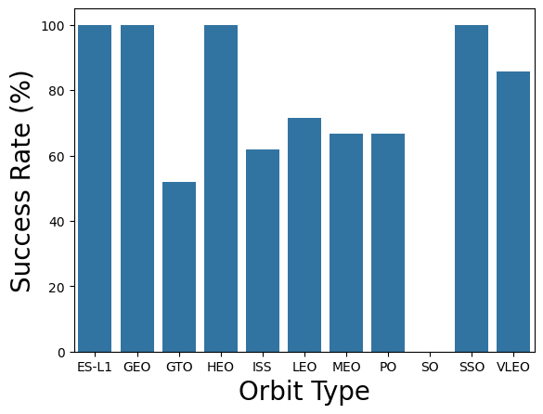
Success Rate vs. Orbit Type
Exploratory Data Analysis:
SO has 0% success rate.
SSO, HEO, EQ-L1 and GEO has 100% success rate.

Slide 21
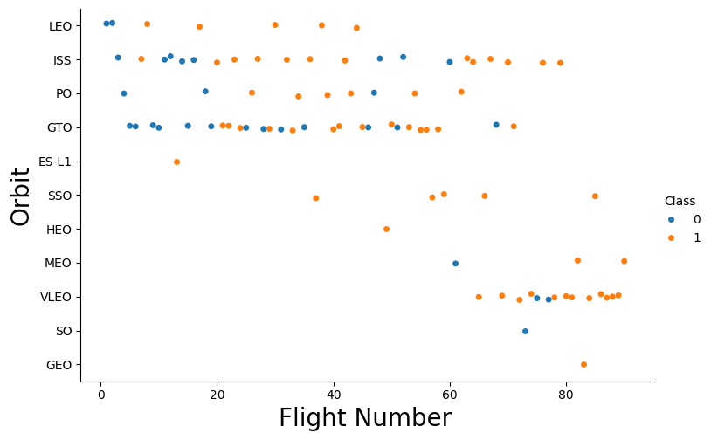
Flight Number vs. Orbit Type
Exploratory Data Analysis:
LEO success rate is related to number of flights.
GTO and ISS does not follow this trend.
SSO is 100% successful irrelative of flight numbers.

Slide 22
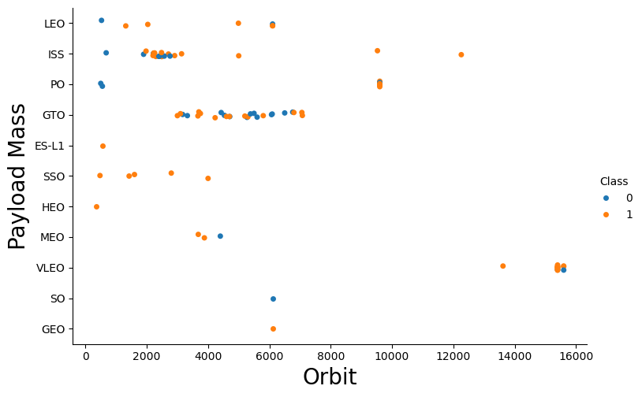

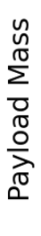
Payload vs. Orbit Type
Exploratory Data Analysis:
GTO has mixed success with payload
Flights with 8000 kg payload has higher success rate.
ES-L1, SSO and HEO has 100% success rate, but higher payload weren’t used for these orbits.

Slide 23
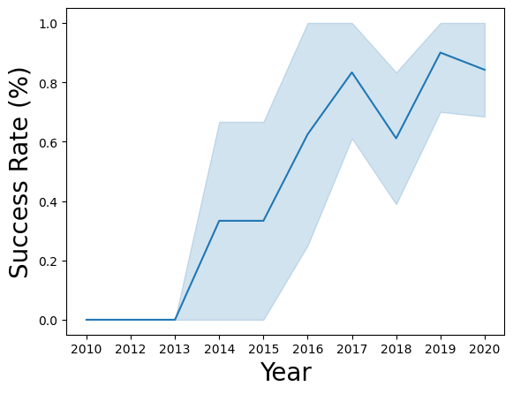
Launch Success Yearly Trend
Exploratory Data Analysis:
Success rate increased from 2013-2017 and 2018-2019.
Success rate decreased in 2017-2018 and 2019-2020.
Initial success rate was 0.

Slide 24
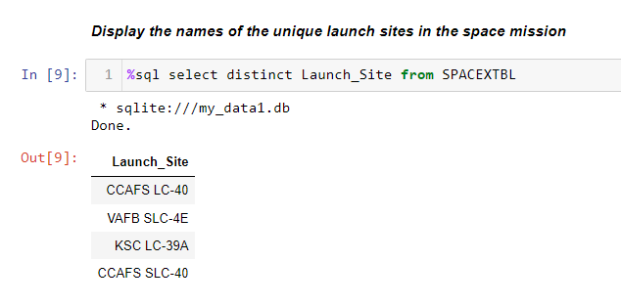
All Launch Site Names
Launch Site Names:
CCAFS LC-40
VAFB SLC-4E
KSC LC-39A
CCAFS SLC-40

Slide 25
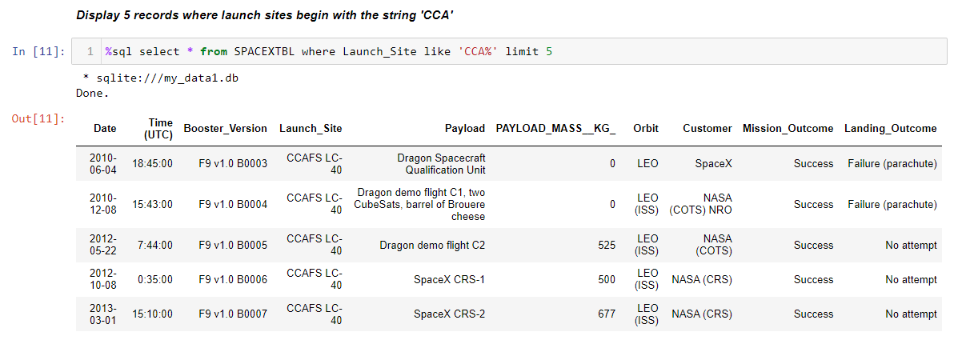
Launch Site Names Begin with 'CCA'

Slide 26
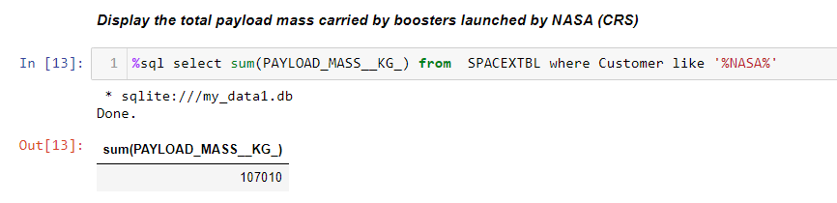
Total Payload Mass
Total payload mass was 107010 Kg

Slide 27
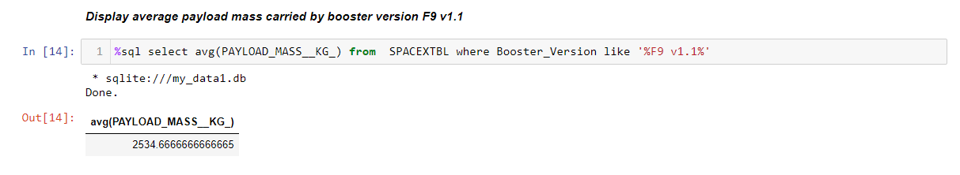
Average Payload Mass by F9 v1.1

Slide 28
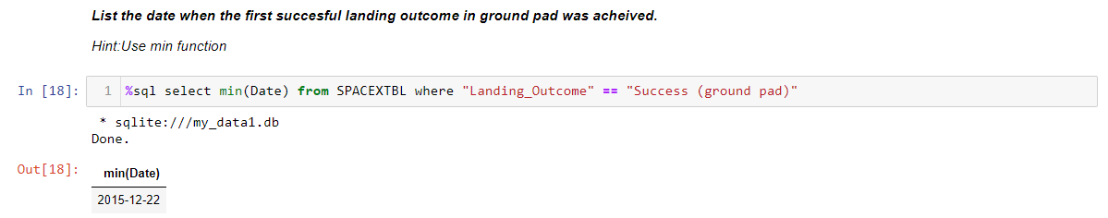
First Successful Ground Landing Date

Slide 29
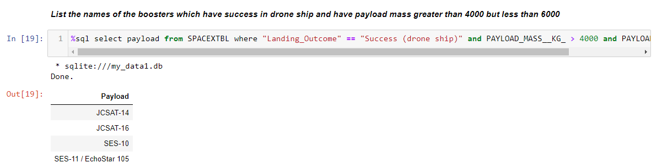
Successful Drone Ship Landing with Payload between 4000 and 6000

Slide 30
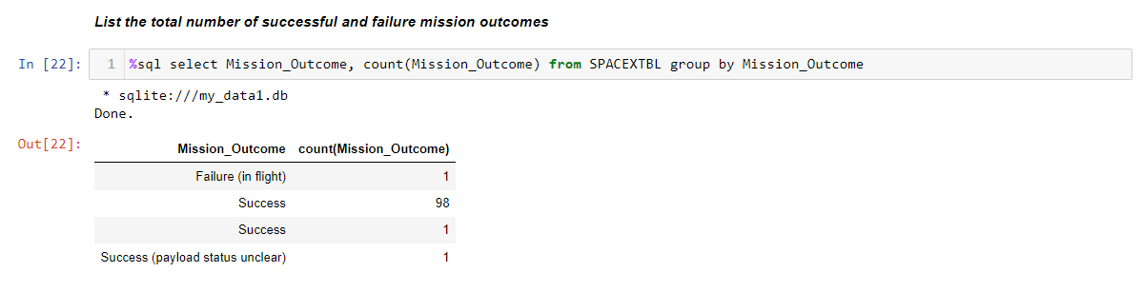
Total Number of Successful and Failure Mission Outcomes

Slide 31
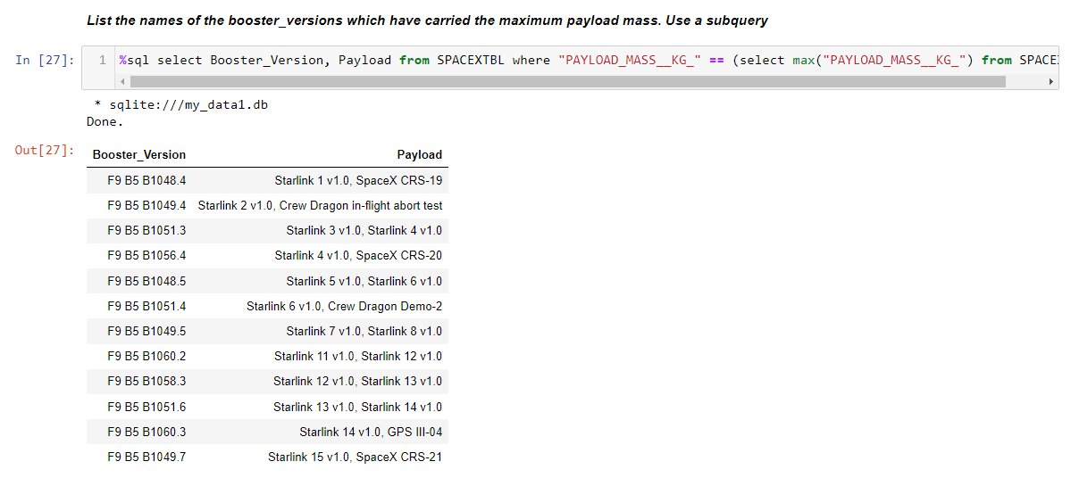
Boosters Carried Maximum Payload

Slide 32
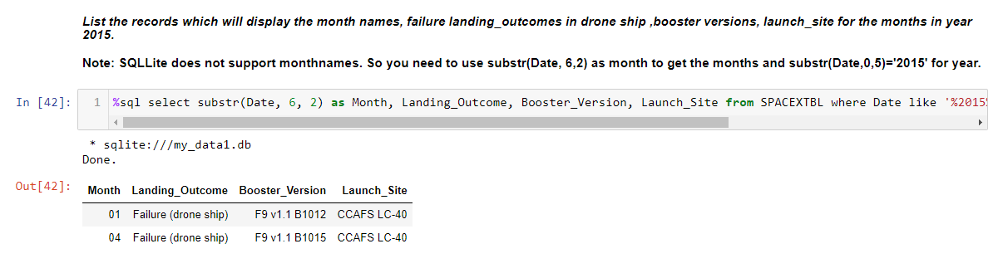
2015 Launch Records

Slide 33
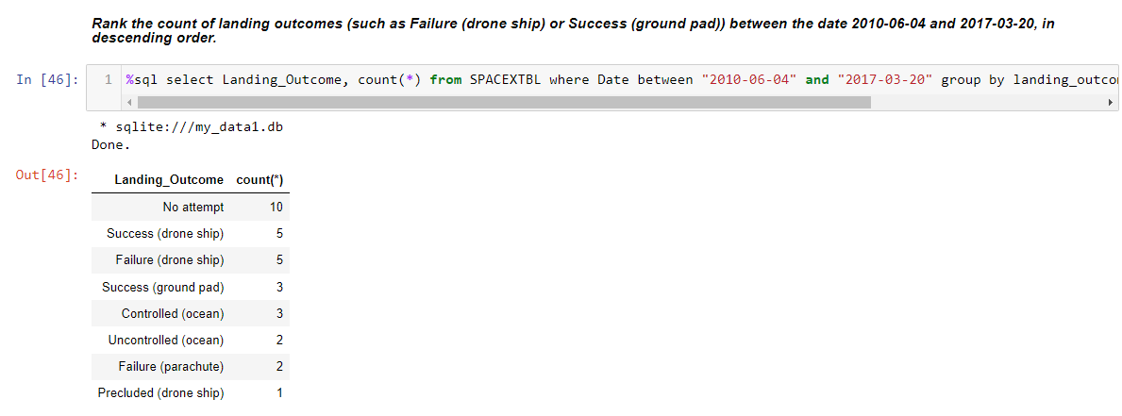
Rank Landing Outcomes Between 2010-06-04 and 2017-03-20

Slide 34

Section 3

Slide 35
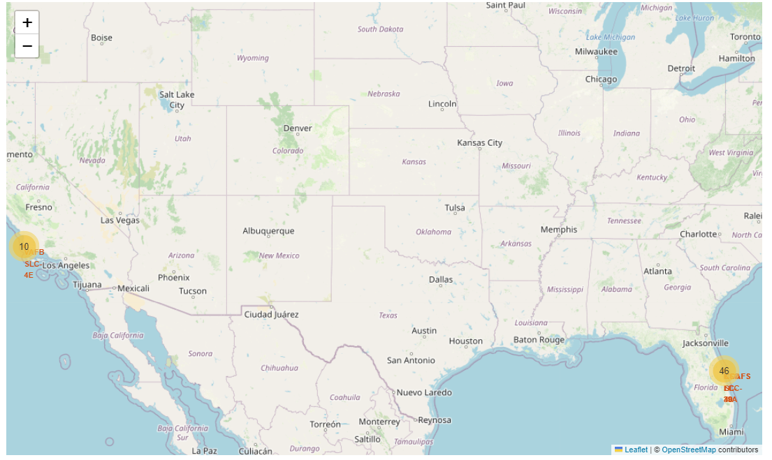
Launch Sites
SpaceX Launch sites were selected in coastal regions, Florida and California

Slide 36
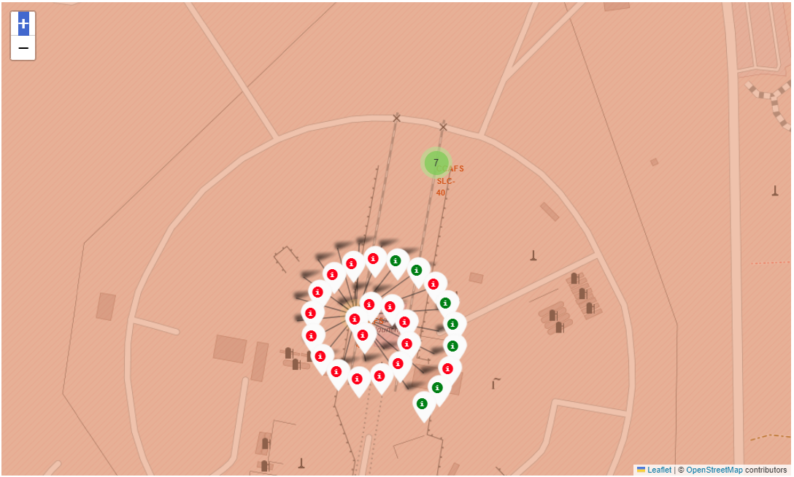
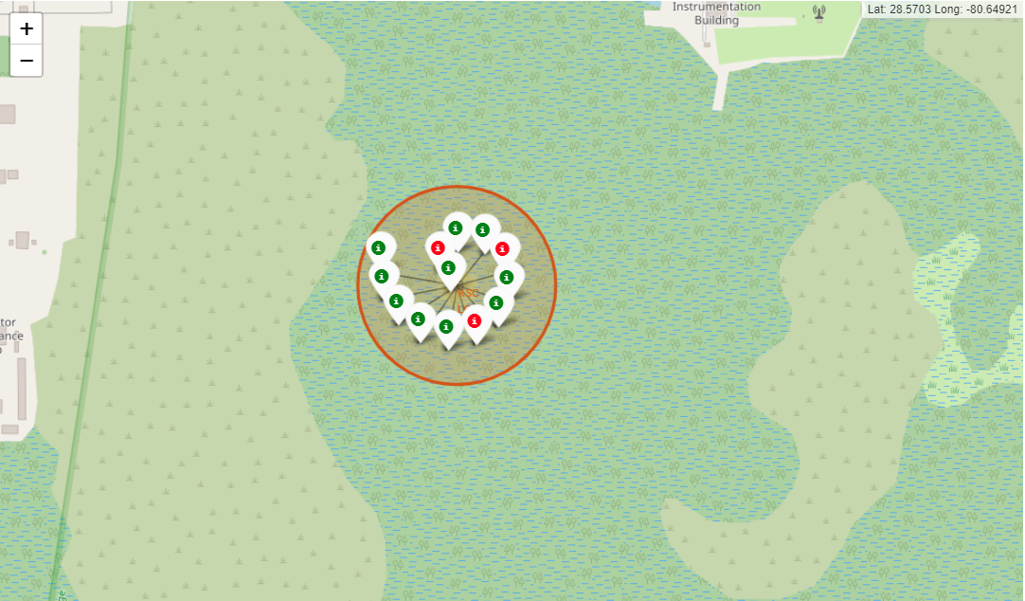
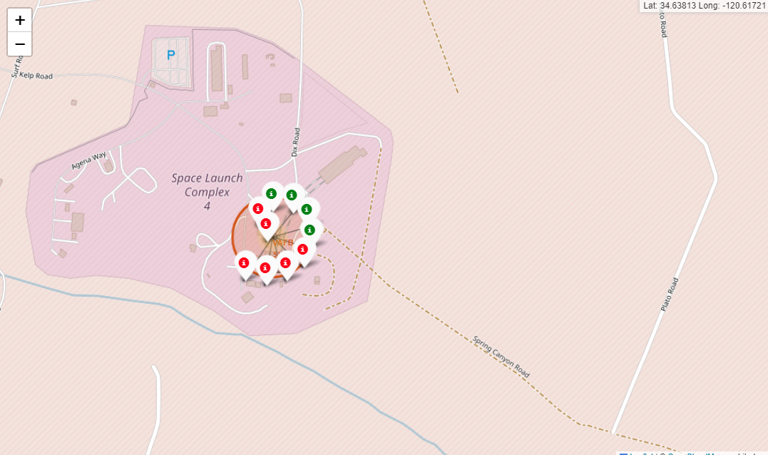
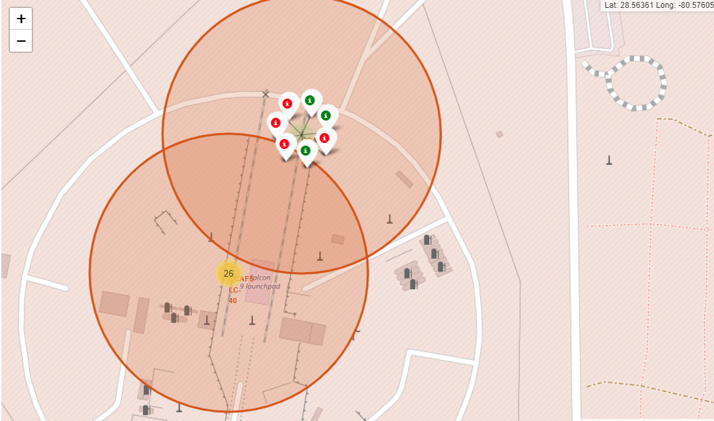
Launch Outcome
Green Markers indicate Successful Launches
Red markers indicate unsuccessful launches
Florida Launch Sites
California Launch Site

Slide 37
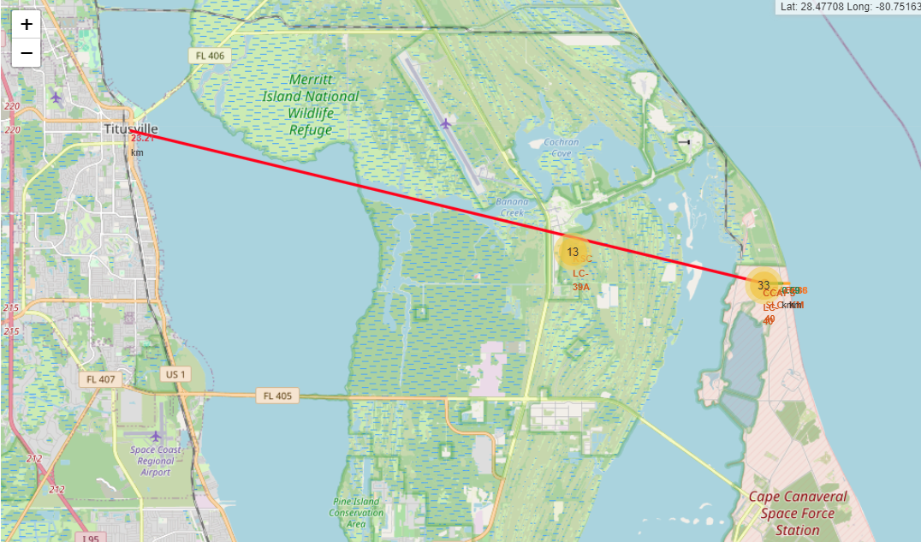
Launch site distance to Landmarks
CCAFS SLC-40
• .88 km from nearest coastline
• .59 km from nearest railway
• 23.21 km from nearest city
• .59 km from nearest highway

Slide 38

Section 4

Slide 39
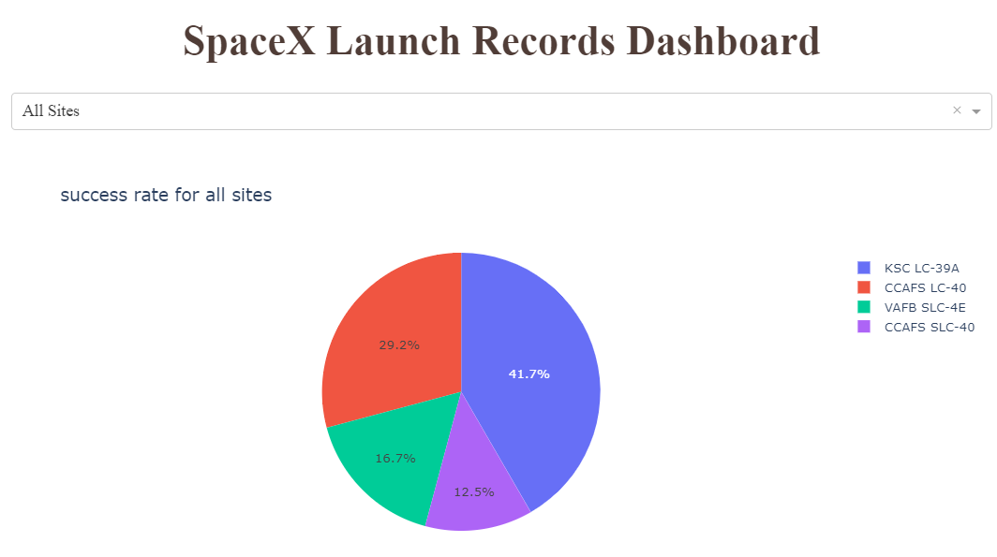
Success rate for all sites
KSC LC-39A has the most successful launches.
CCAFS SLC-40 has the worst.

Slide 40
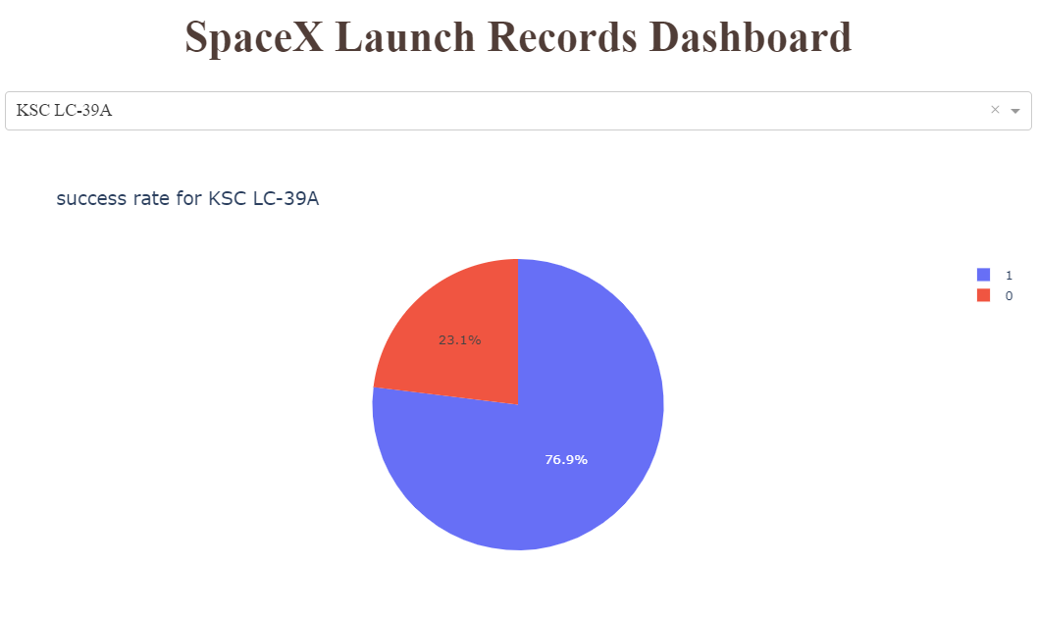
Highest launch success rate
KSC LC-39A has the highest success rate with 76.9%.

Slide 41
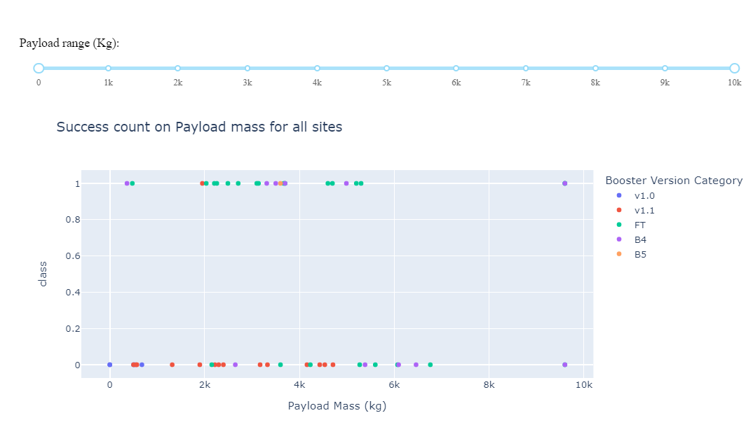
Payload Vs. Success
1 is indicating the successful launch and 0 is indicating an unsuccessful launch

Slide 42

Section 5

Slide 43
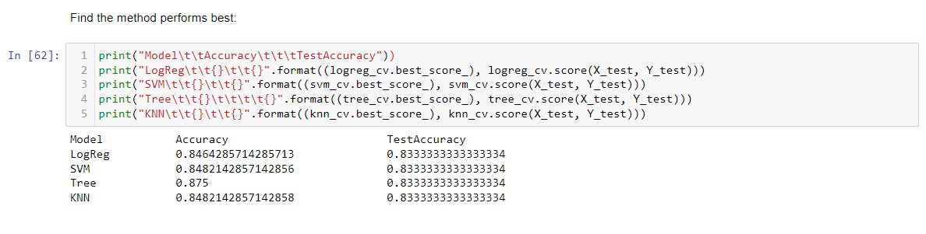
Classification Accuracy
All model's performance is about the same, but the Decision tree model has the slightly better performance

Slide 44
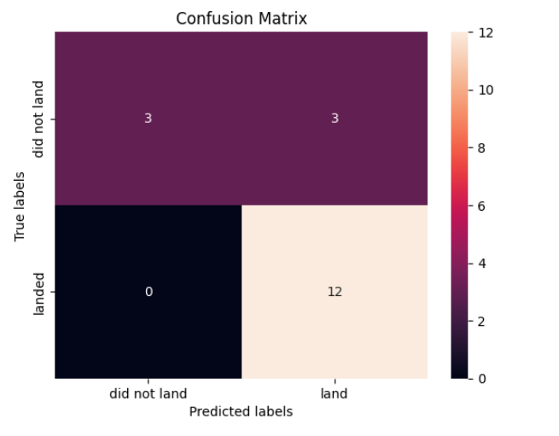
Confusion Matrix
Confusion Matrix Outputs:
- 12 True positive
- 3 True negative
- 3 False positive
- 0 False Negative
Precision = TP / (TP + FP) = 0.80
Recall = TP / (TP + FN) = 1.0
F1 Score = 2 * (Precision * Recall) / (Precision + Recall)= 0.89
Accuracy = (TP + TN) / (TP + TN + FP + FN) = 0.833

Slide 45
Conclusions
The models performed similarly on the test set with the decision tree model slightly outperforming
Launch Success increases over time
KSC LC-39A has the highest success rate among launch sites.
Orbits ES-L1, GEO, HEO, and SSO have a 100% success rate
Across all launch sites, the higher the payload mass (kg), the higher the success rate

Slide 46


